Slide 1
The Scrum-Agile Approach

Slide 2
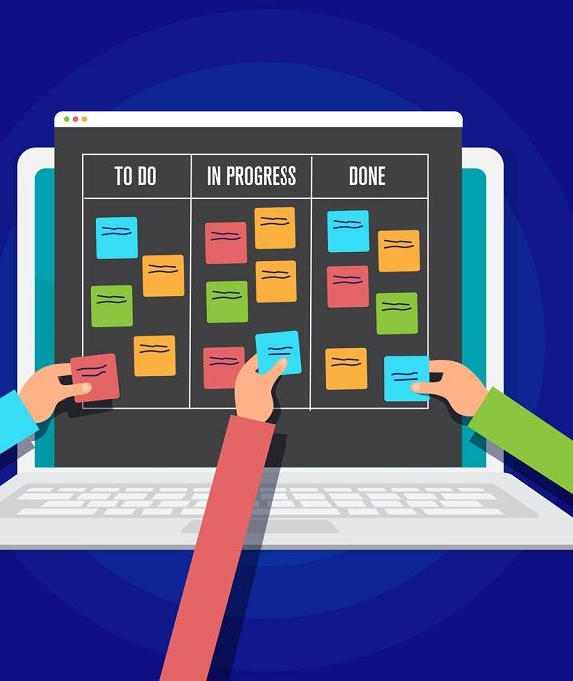
The Scrum Roles

Slide 3
Product Owner
“The product owner is the person who connects two key functions and associated groups of people: the ones who identify what value is needed (the business) and the ones who determine how and implement it (development team)” (Project Manager Institute).
Connects with the users to get user stories
Relays the user stories back to the team so they can create solutions
Manage the team backlog as needed
Occasionally assist with software release factors such as marketing, support, timing, pricing, etc…

Slide 4
Scrum Master
Acts as a sort of coach for team members when it comes to scrum-agile methodology
Host certain scrum events such as daily scrum, sprint review, retrospective or sprint planning
Functions as a servant leader for the team to assist them where needed, always looking out for the team
Helps to refine the product/sprint backlog and assist the team in prioritizing what needs to be done

Slide 5
Tester
“To be effective the tester needs to coach the team through every stage of the lifecycle, from requirement to completed product, by helping the team be clear around the tasks of each phase” (Scrum.org).
Work with the product owner to determine exactly what the deliverable should be
Design test cases based on the feedback from the customers provided by the product owner
Work with the development team to determine when code meets the test case requirements
Give the final sign off on when a sprint is complete

Slide 6
The Development Team
Create the code that is going to be used on the final deliverable
Work with the tester to determine when code passes or fails
Attend meetings such as the daily scrum to perform progress checks and get assistance when needed

Slide 7
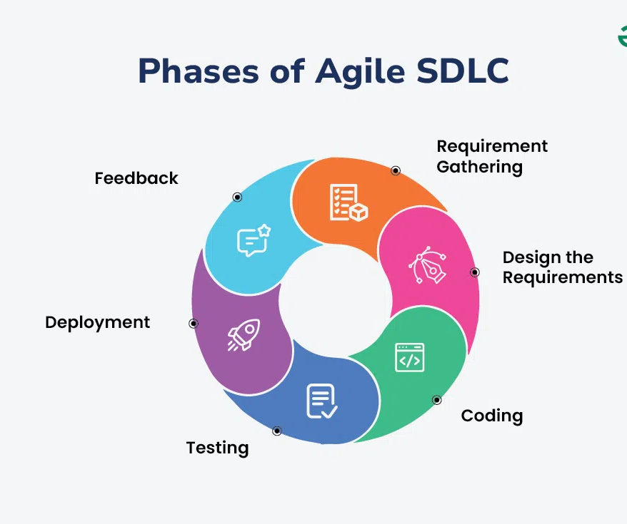
The Agile Phases
Geeks For Geeks

Slide 8
An Iterative Process
The software development lifecycle of agile is circular, such that the process is constantly iterating and repeating itself
The process is not linear, and steps can be repeated many times before moving on to the next
Agile is adaptive so that when new problems or interruptions arrive the team can adjust to the new requirements

Slide 9
Requirement Gathering and Design the Requirements
The first step is always to determine what needs to be done for the team
This often involves the product owner meeting with the end users and determining the requirements with them
The team and scrum master will then take the information and create sprints out of it
Priority will be assigned and the team will begin working on sprints with the highest priority

Slide 10
Coding and Testing
The tester will create test cases based on the user stories that the product owner has created
The development team will work to pass the test cases and therefore complete the user stories

Slide 11
Deployment and Feedback
Once the code has passed the test cases it will get deployed to the customer
This deployment will take place as a software update on the main branch of code
The product owner is then tasked again with getting feedback from the users on what is good and what is bad with this new deployment
The process then repeats itself as the product owner takes back this information and any new information to the team

Slide 12
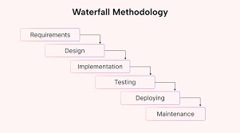
What If We used Waterfall Instead?
Motion

Slide 13
What is Waterfall
“Like a waterfall, each process phase cascades downward sequentially through five stages (requirements, design, implementation, verification, and maintenance)” (Atlassian).
stages happen sequentially with no iteration
The next stage is not started until the end of the previous stage is reached
There is no moving back to a previous stage if the team has already moved on to the next
This can leave customers feeling unheard as the team continues to work on new designs instead of listening for feedback

Slide 14
What if we used waterfall?
Some foreseeable problems could occur if we used the waterfall method
Thinking back to when the team was tasked with creating a top 5 wellness vacations, they were in the middle of a different task. In a waterfall scenario, this new wellness vacations task would not be started until the team was complete the previous task
There would not have been constant feedback from the customers on what they want in product. That would only occur in the requirement gathering phase and not be revisited until the rest of the development is complete.
The number of meetings and therefore communal knowledge on the project would be much less without events such as daily scrum

Slide 15

Waterfall Vs. Agile

Slide 16
Final Verdict
Agile was the right move here due to the constantly evolving requirements that SNHU Travel provided
The constant user-stories was perfect for the scrum-agile methodology to accommodate due to its iterative software development life cycle
The constant meeting with customers to get feedback on what they want to see changed is helpful in creating a product that end users love
The communication lines that meetings such as the daily scrum give the teams is valuable in expanding the knowledge on the product and getting the most out of every interaction.

Slide 17
References
Product owner. Project Manager Institute. (2025). https://www.pmi.org/disciplined-agile/product-owner
The Role of a Professional Tester in an Agile World. (n.d.). Scrum.org. https://www.scrum.org/resources/blog/role-professional-tester-agile-world
GeeksforGeeks. (2021, October 15). Agile SDLC (Software Development Life Cycle). GeeksforGeeks. https://www.geeksforgeeks.org/software-engineering/agile-sdlc-software-development-life-cycle/
‌Atlassian. (2025). Waterfall Methodology for Project Management. Atlassian. https://www.atlassian.com/agile/project-management/waterfall-methodology

